Slide 1
Update on Ophiuchus with DR 2
May 14, 2018

Slide 2
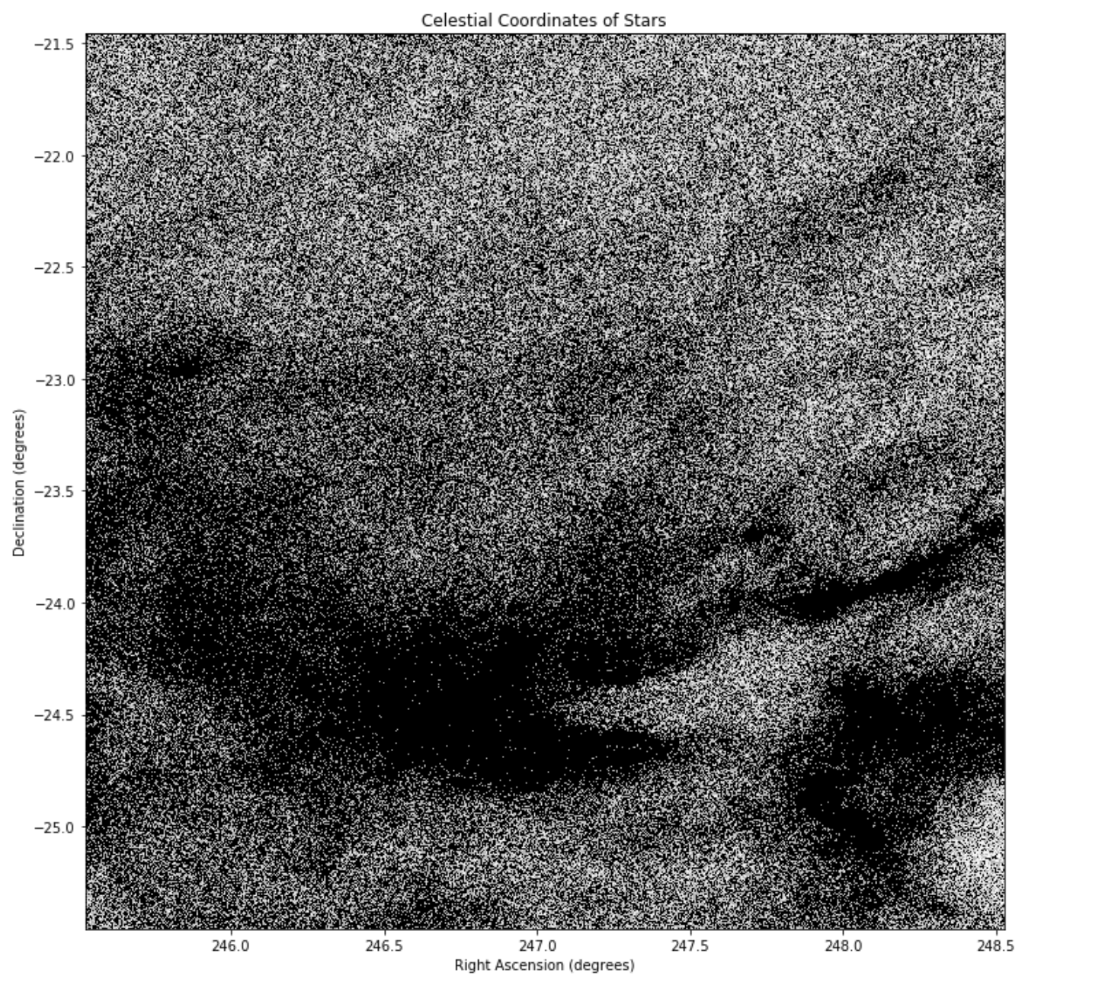
Sky Plot (RA/Dec Locations)

Slide 3
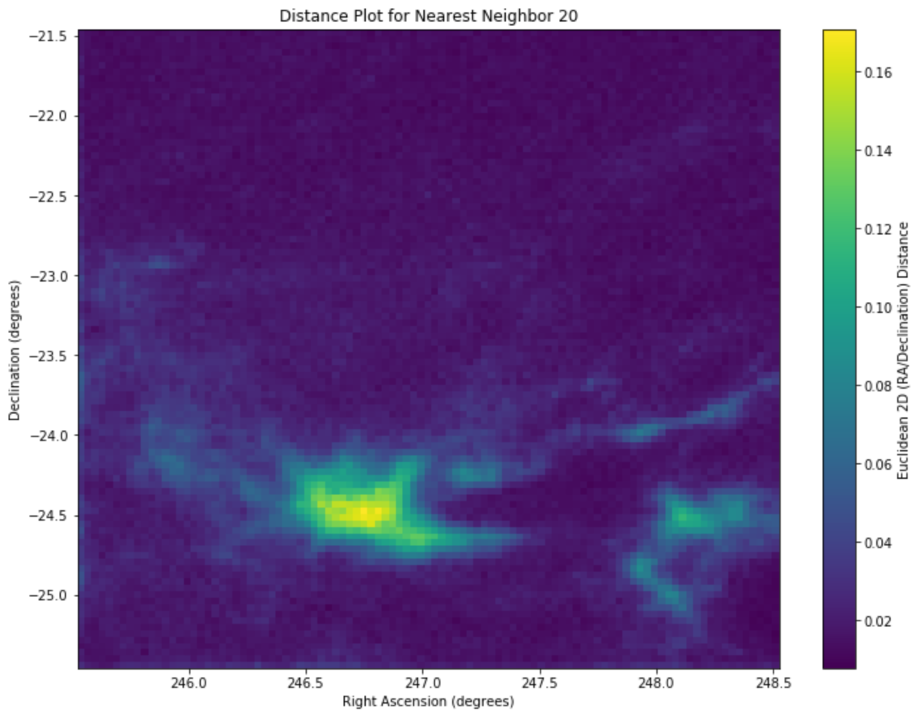
2D (RA/Dec) Distance Map (k=20)

Slide 4
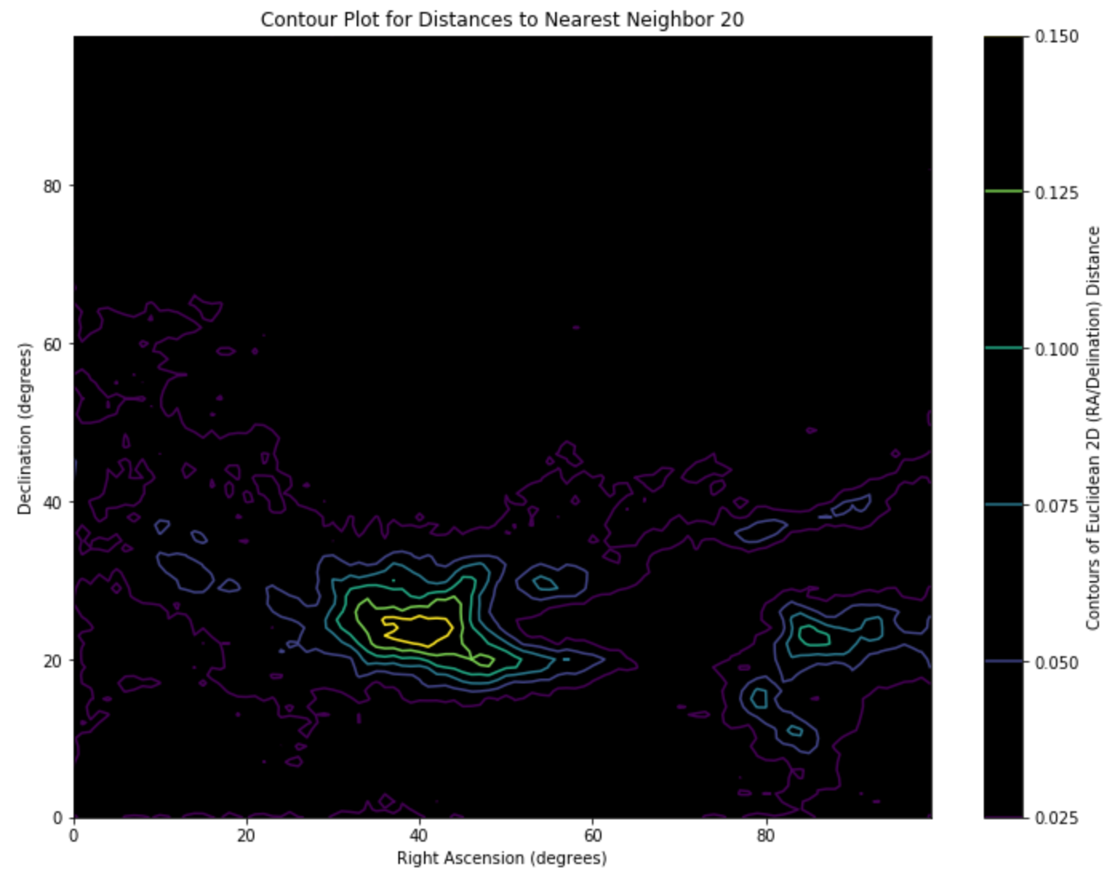
2D (RA/Dec) Contour Plot

Slide 5
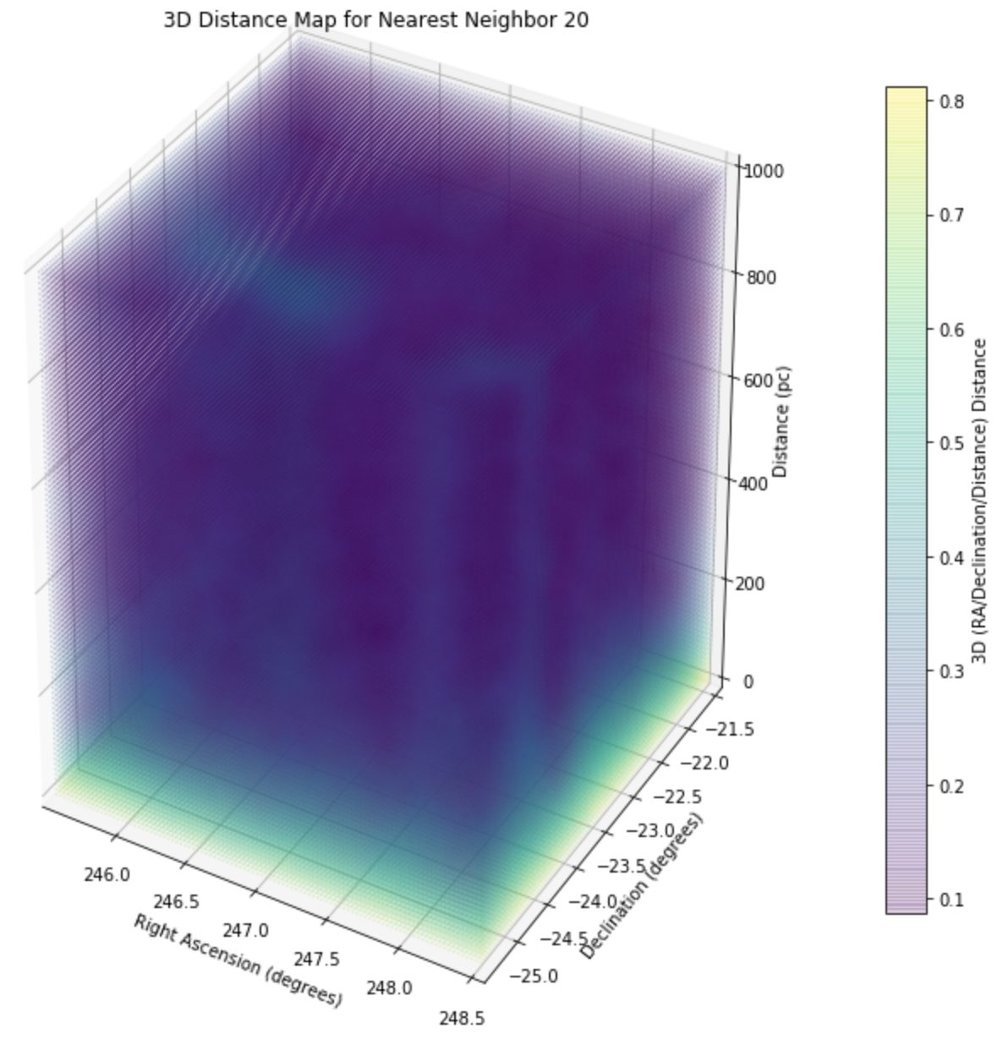
Fixed 3D Distance Map

Slide 6
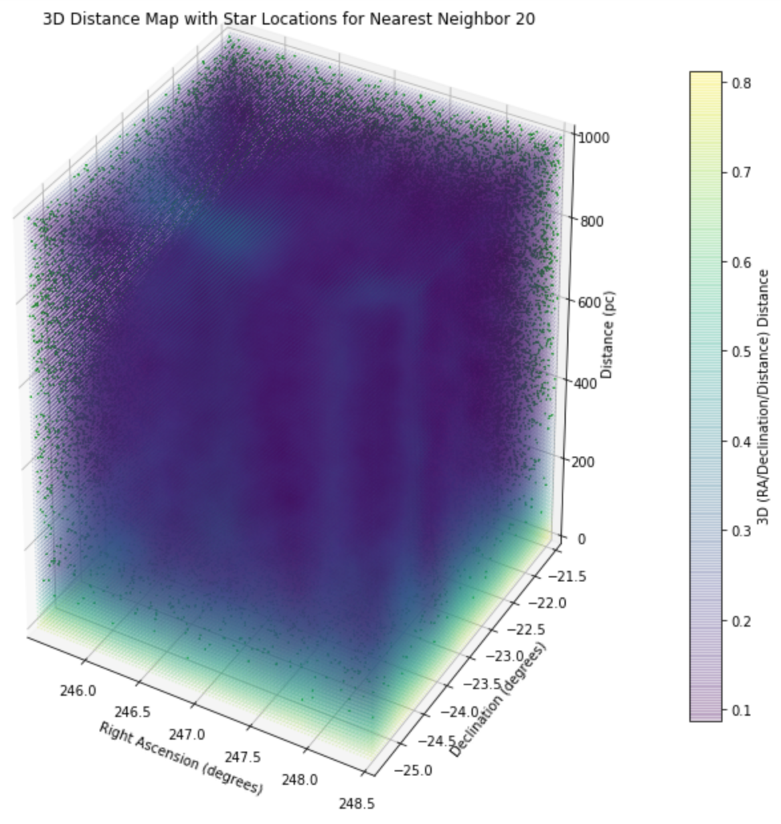
Fixed 3D Distance Map with Stars

Slide 7
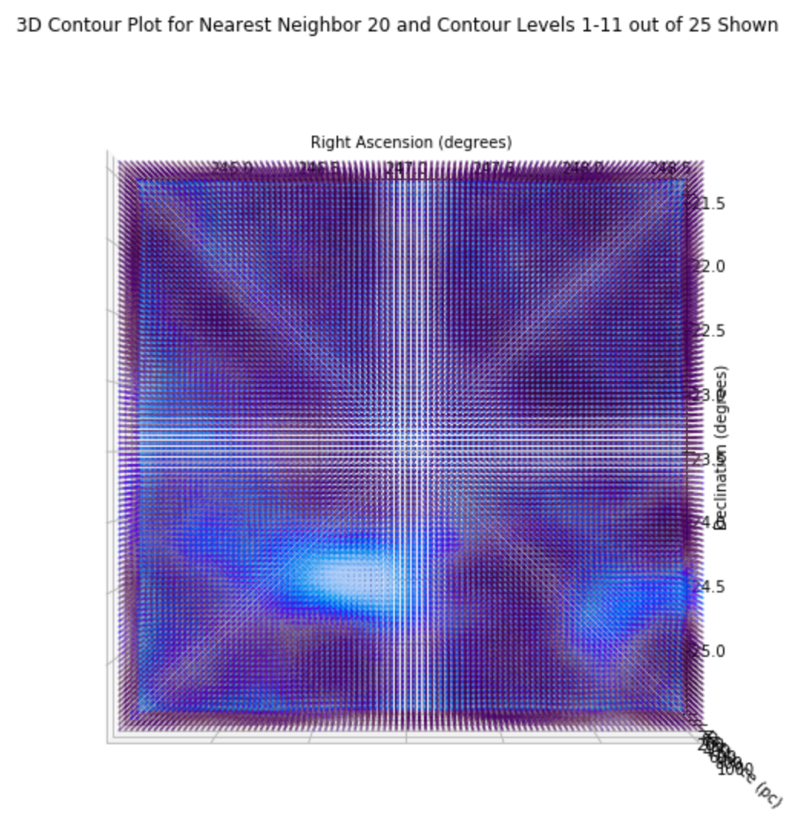
Top View 3D Contours 1-11

Slide 8
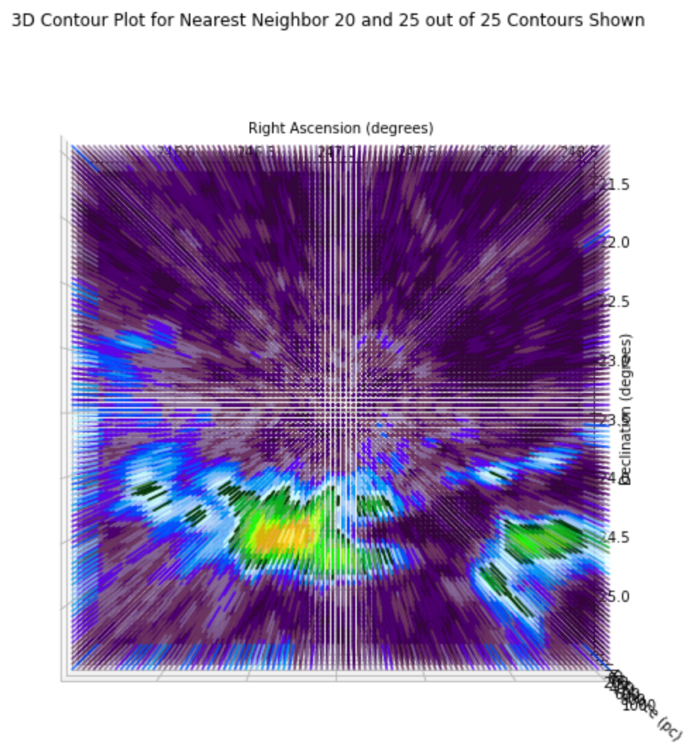
Top View 3D Contour Plot (25/25)

